Slide 1






Bookshop Management System
Name : NURUL AFIQAH BINTI ROSLI
No Matric : B032310083
Supervisor : TS. DR. MUHAMMAD HAZIQ LIM BIN ABDULLAH
Evaluator : TS. DR. HAMZAH ASYRANI BIN SULAIMAN

Slide 2

Introduction
The Smart Bookshop Management System will be developed to upgrade the manual system with a more user-friendly computer system for all kinds of operations in the bookshop. In the current system, all the activities are done manually. It is very time-consuming and costly. With the development of this system, it can help users solve problems.
The most typical difficulty in managing the Bookshop Management System is that the data is unsystematic and information is not recorded. The data is recorded manually using a paper-based approach. The other issue is that it has a limited system and is currently using direct selling because customers cannot buy books due to overcrowding in stores.
The proposed project is being developed to improve the quality of the system that is being used by admins, members, and cashiers. system that can provide a more practical method of managing data. The information will be sent directly to the database.

Slide 3


Problem Statement
The data is recorded manually in a paper-based approach
Limited system and using direct selling.
Unsystematic data and information recording.

Slide 4





Objectives
To identify the requirements Bookshop Management System
To develop a Bookshop Management System
To test the Bookshop Management System

Slide 5






Module
Login
Registration
Search
Members
This module authenticates the validity of the user before using the system. Users will have to key in the username and password and if it matches the ones in the database, it will log them into the system.
Administrators and members are permitted to use this module. All required registration information must be entered by the user. For instance, the admin will register the cashier, and the members will register themselves to add their information
Users will be able to search for the book information here such as types, titles and others. The search uses using text-based search technique.
This module is for the usage of staff. It allows member to add, delete, update and view the purchase of book. member also can search book before to purchase the book and make a payment.

Slide 6
Target User
Admin
Members
Cashier
This module is for the usage of administrator. It allows administrators to add, update, delete and view book This module also allows the admin to manipulate anything related to the package. Admin can view report sales
This module is for the usage of staff. It allows member to add, delete, update and view the purchase of book. member also can search book before to purchase the book and make a payment.
This module is for the usage of cashiers. It allows the cashier to receive an order and receipt from the member's purchase. The cashier can also view the report of sales by month.

Slide 7


Project Significance
Makes it possible to store and organize important data more efficiently.
Enables effective customer relationship management. By storing customer information purchase history and preferences in a centralized database
Aids in efficient sales and billing processes. By automating these processes bookshop owners can generate accurate bills track sales trends and analyze sales data to make informed business decisions.

Slide 8


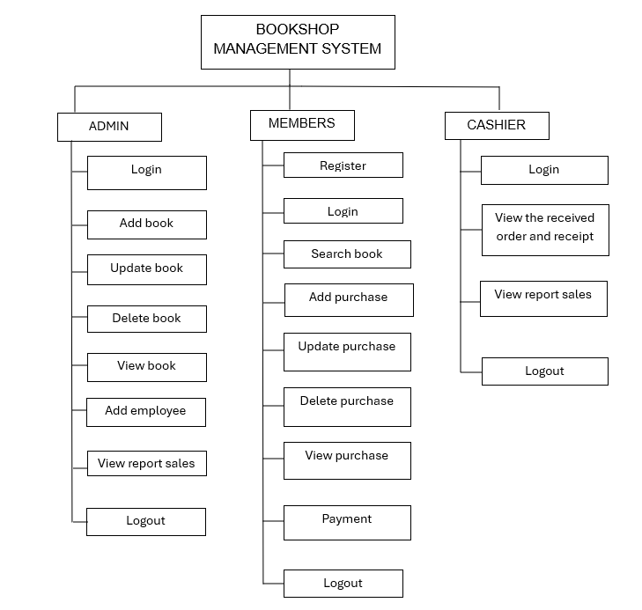

Structure Chart

Slide 9
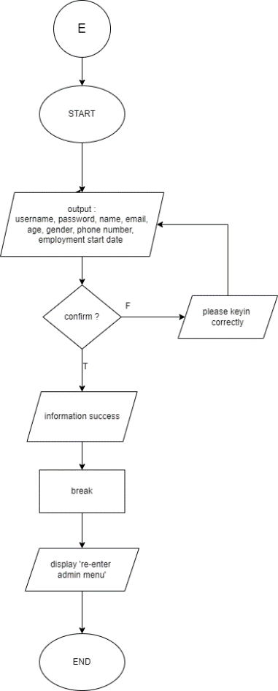
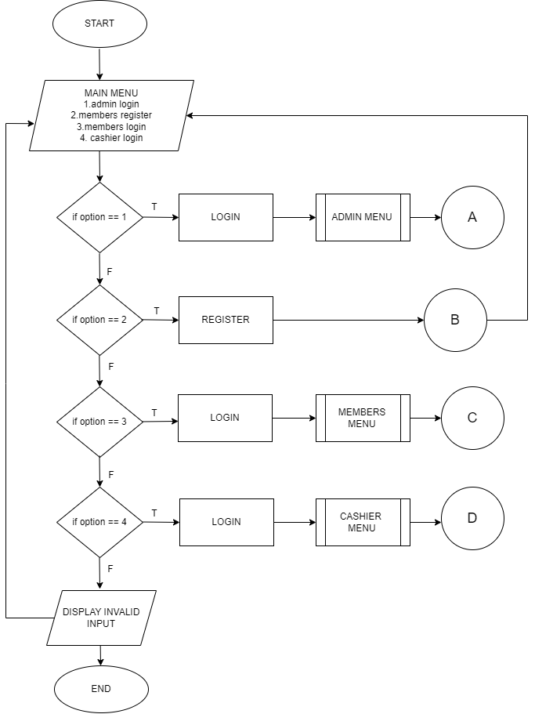
Flowchart
Main menu
Add book

Slide 10
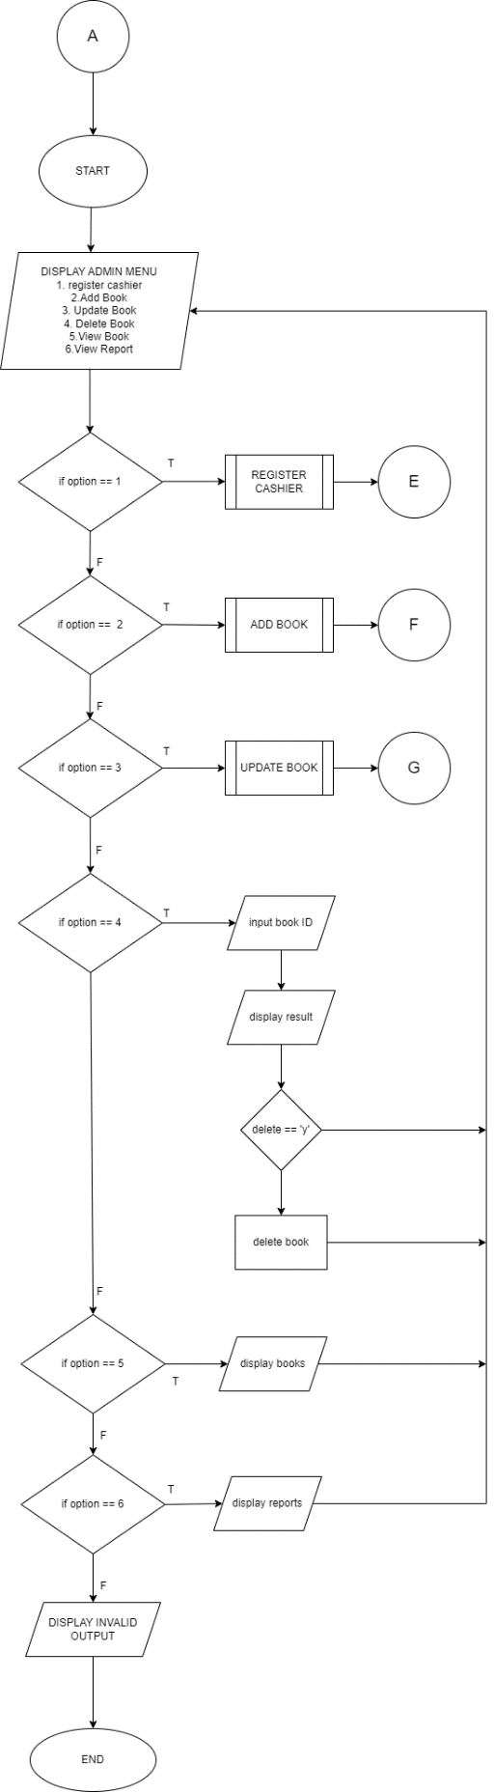
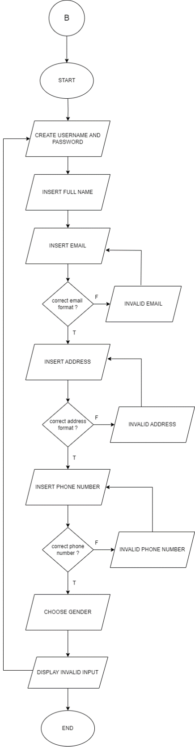
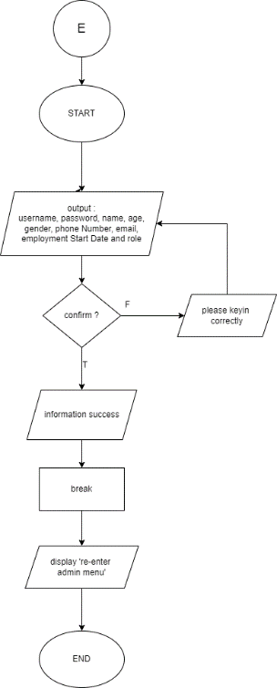
Registration member
Register cashier
Admin menu

Slide 11
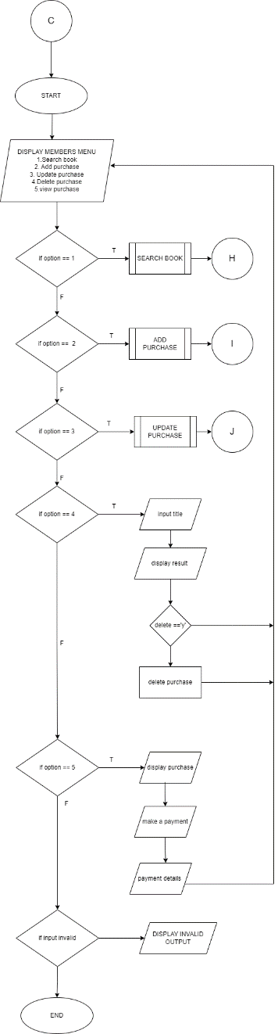
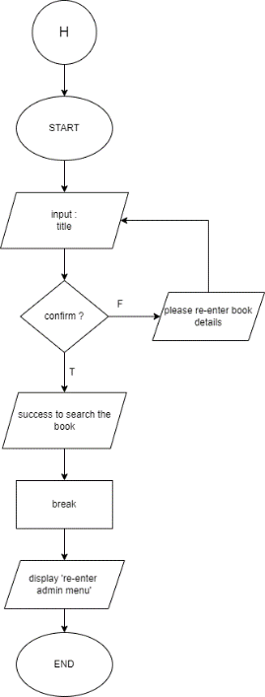
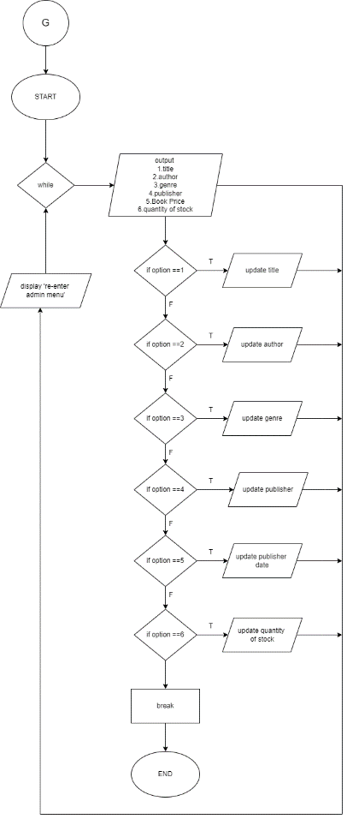
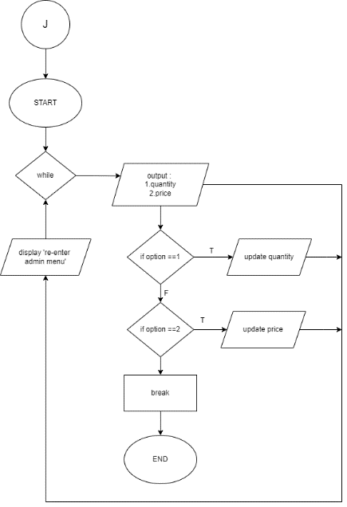
Search book
Add book
Update book
member menu

Slide 12
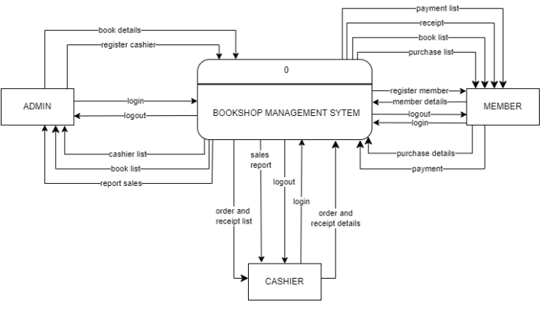
DFD

Slide 13
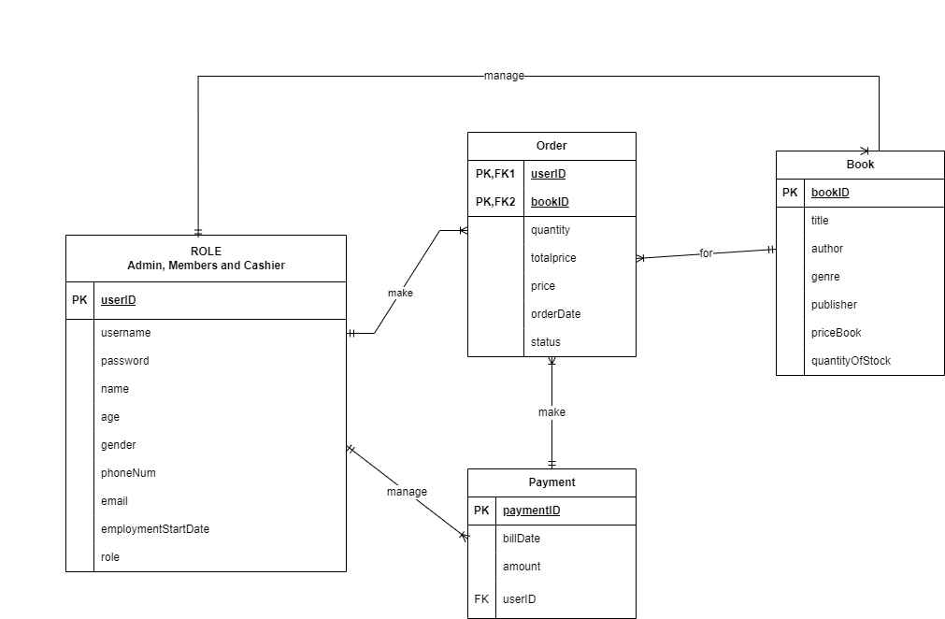
ERD

Slide 14
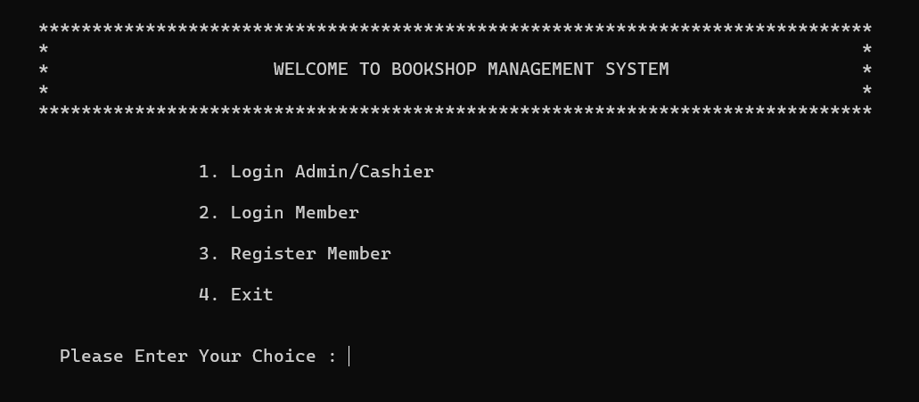

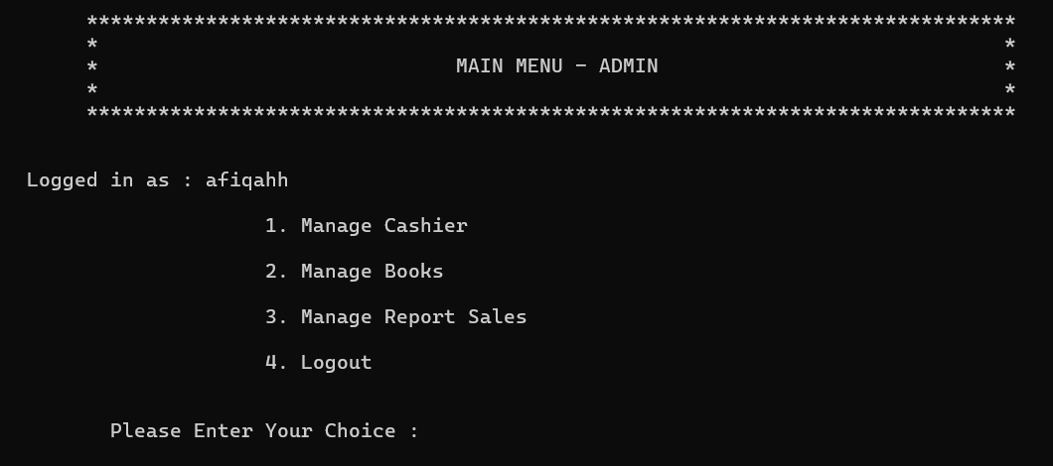
Interface design

Slide 15
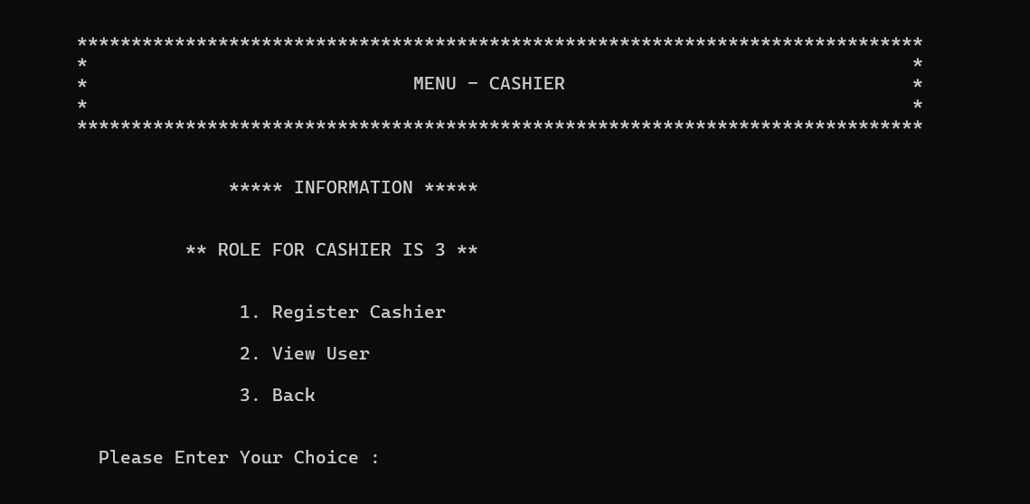
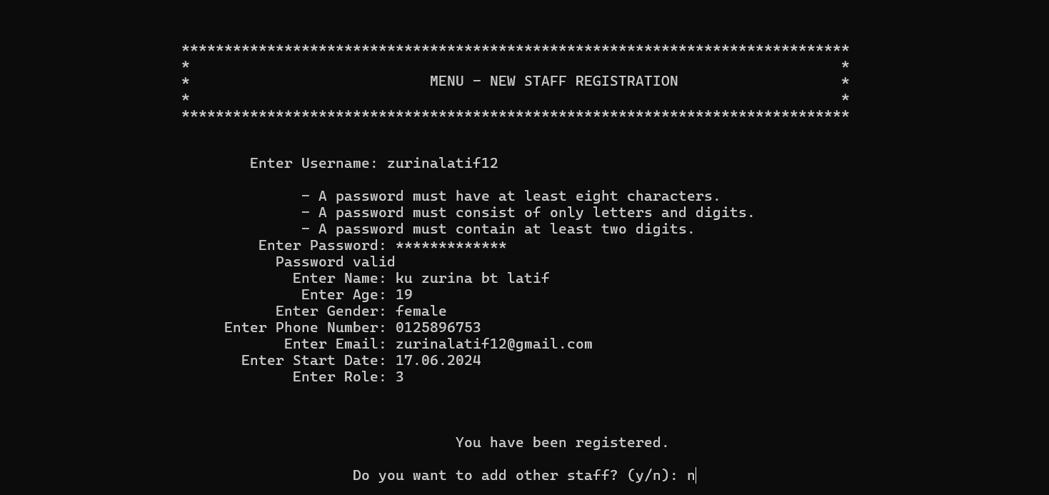
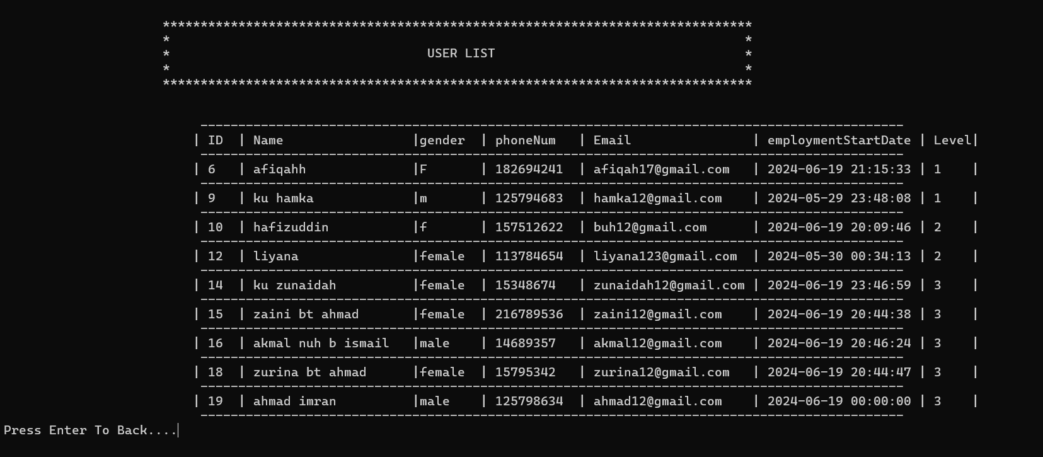

Slide 16
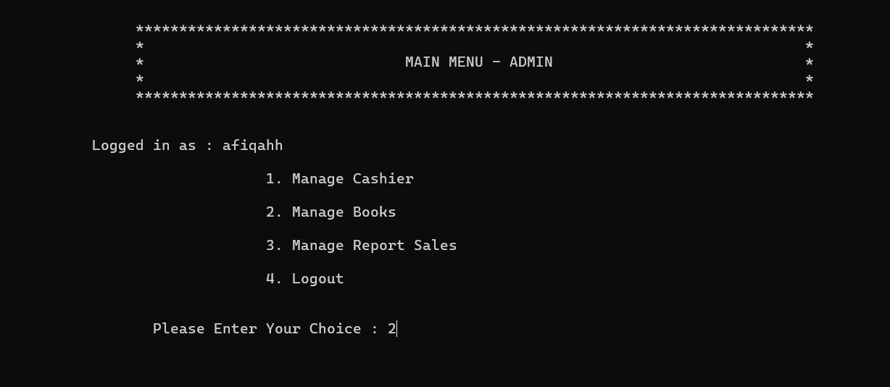


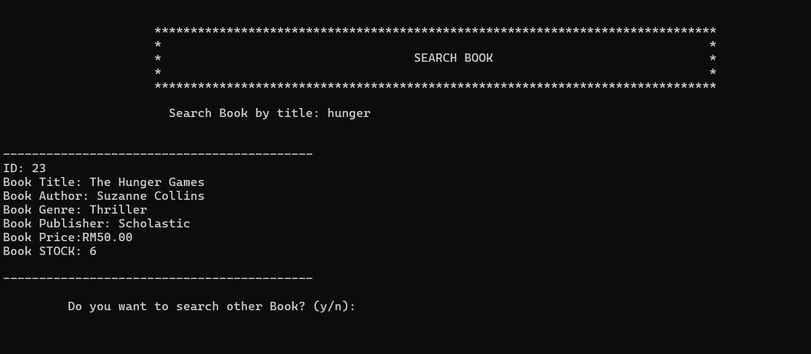

Slide 17
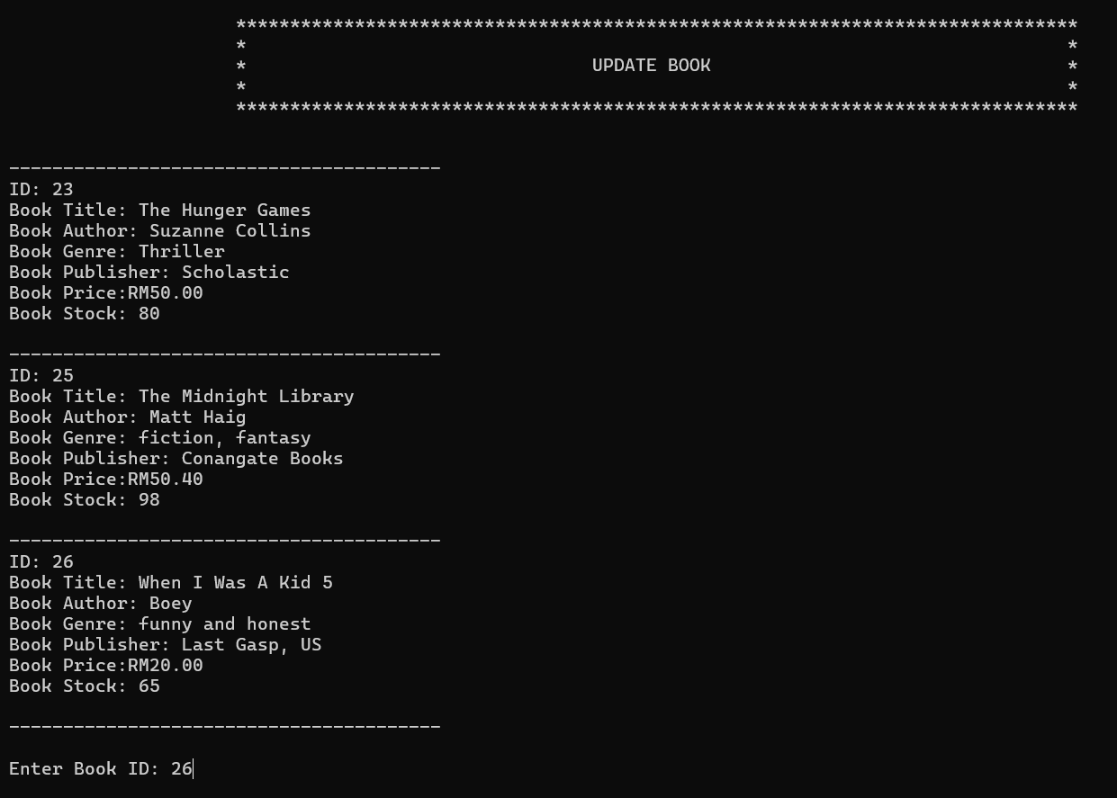
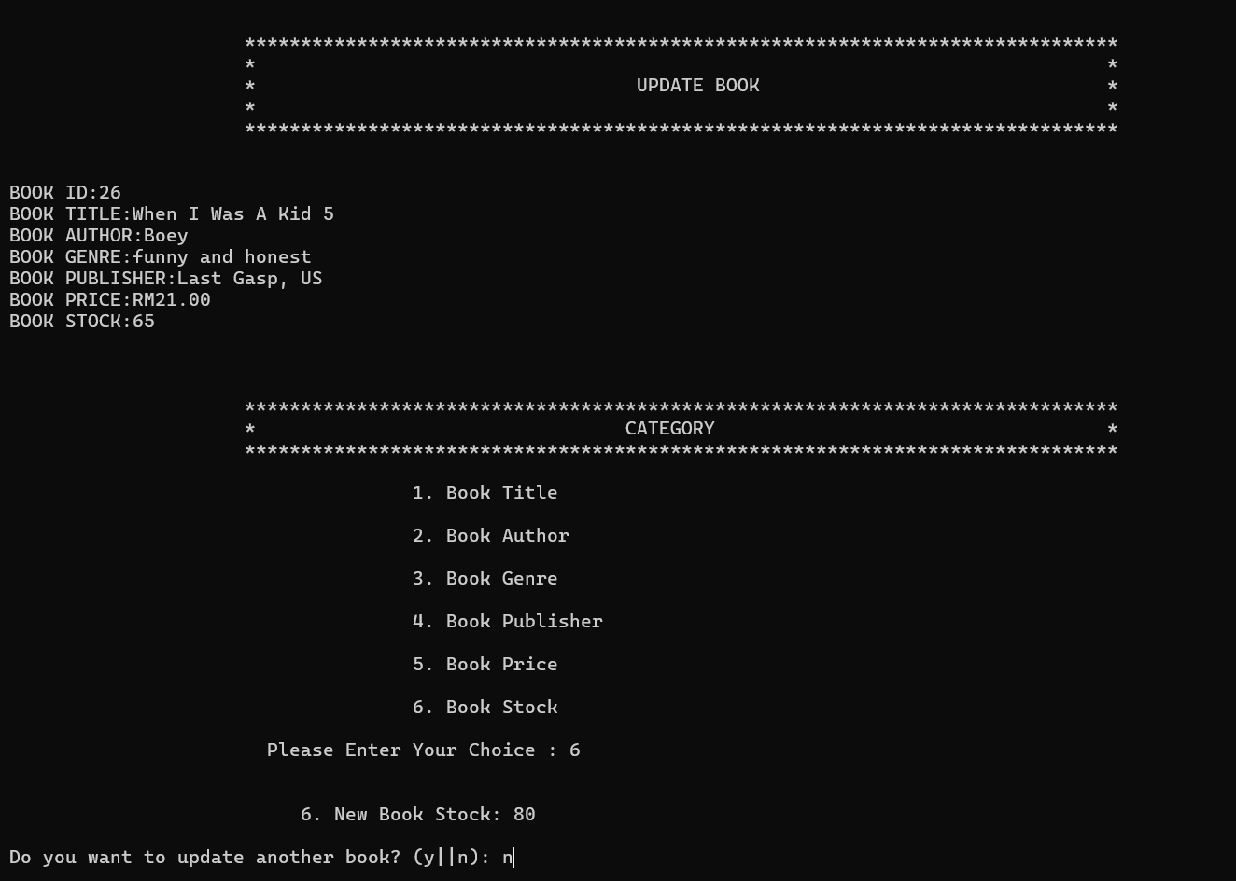


Slide 18
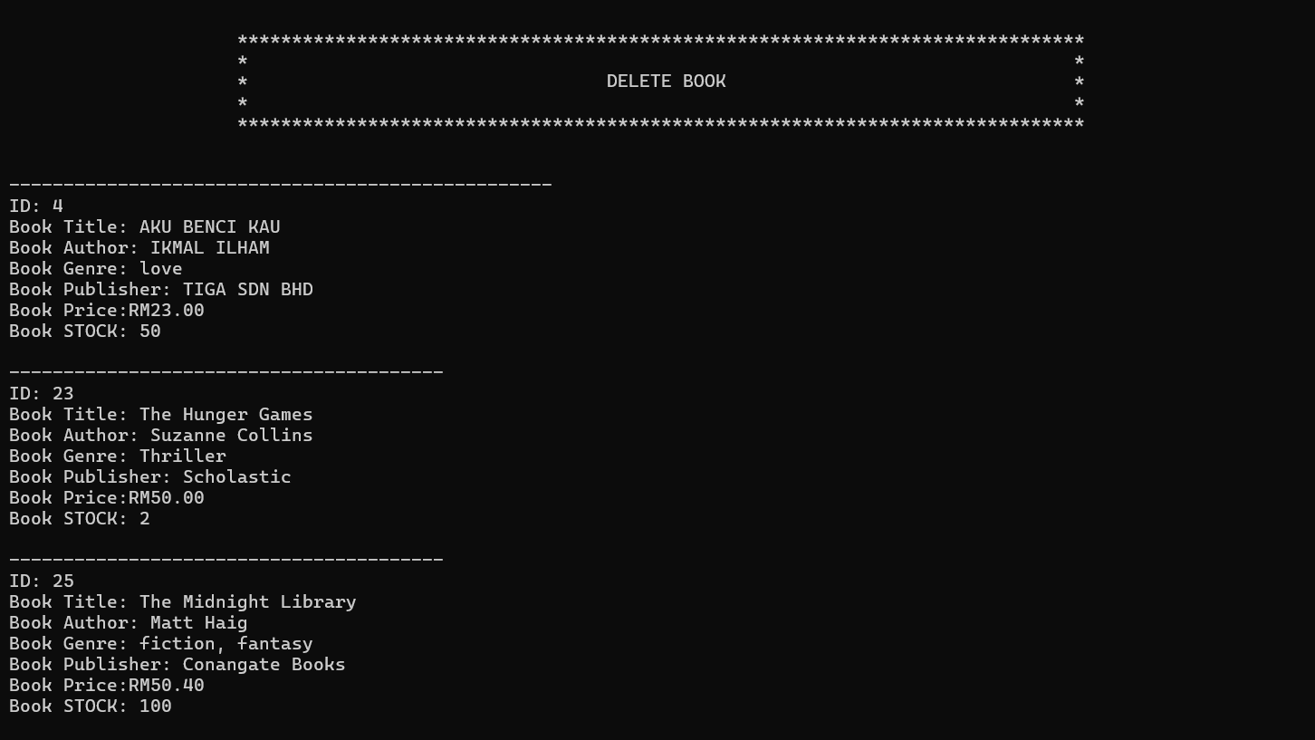


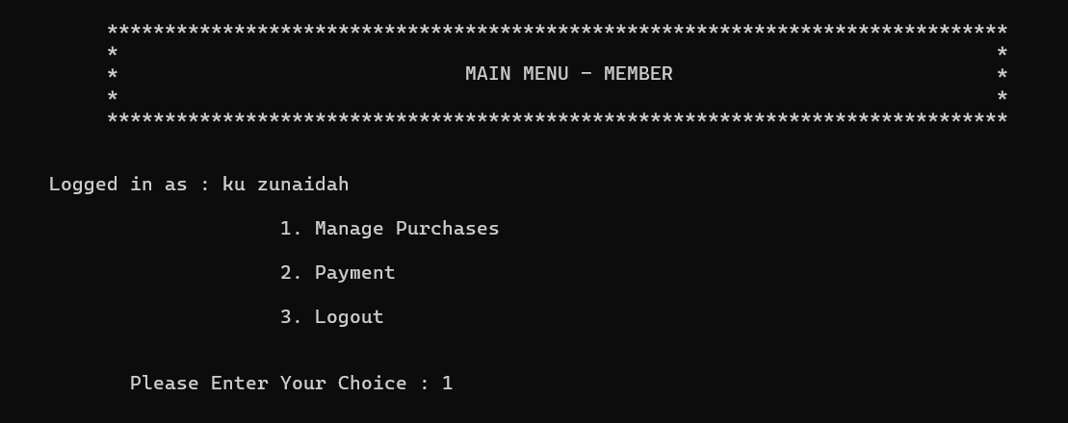


Slide 19
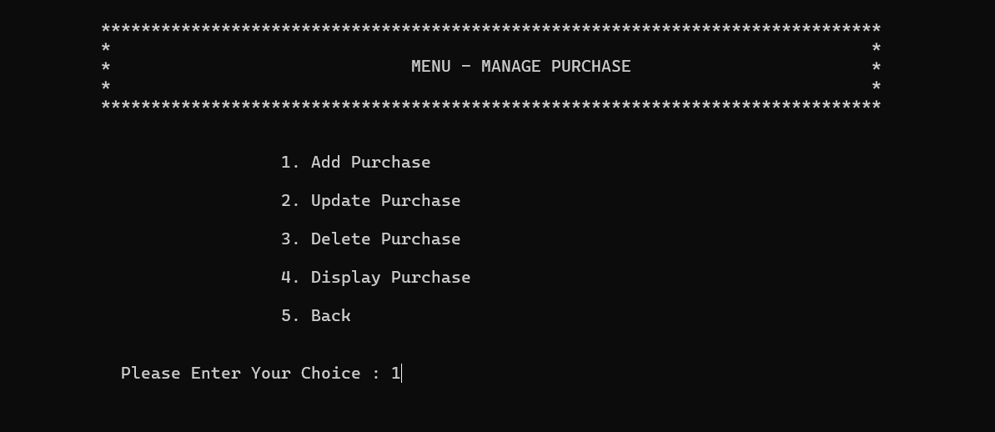
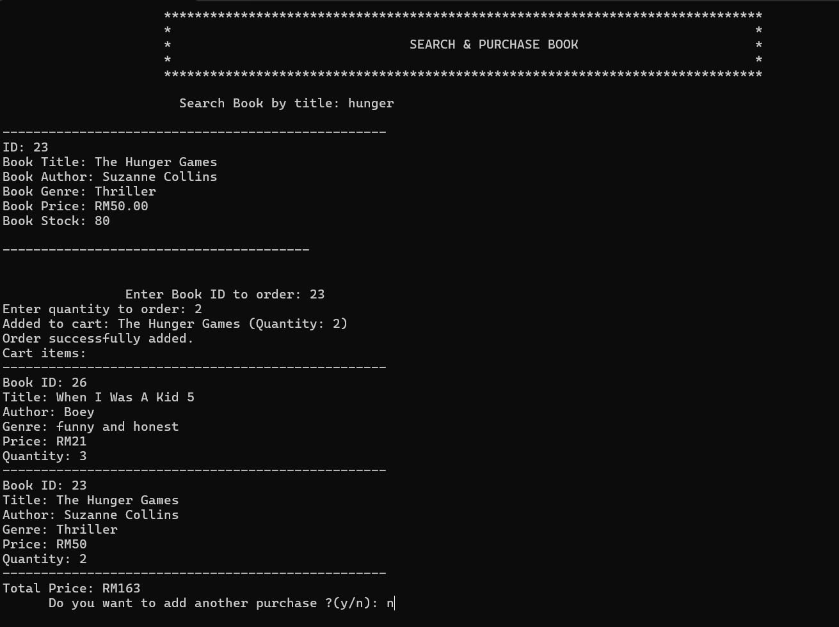
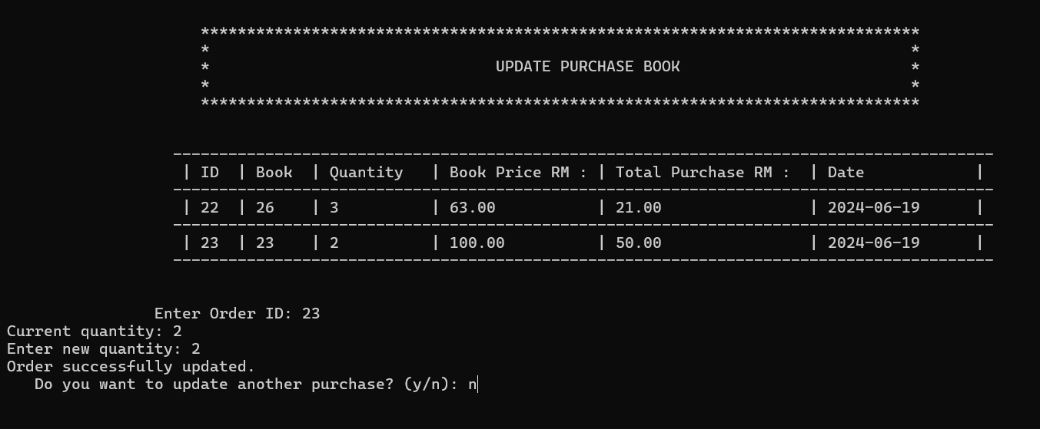
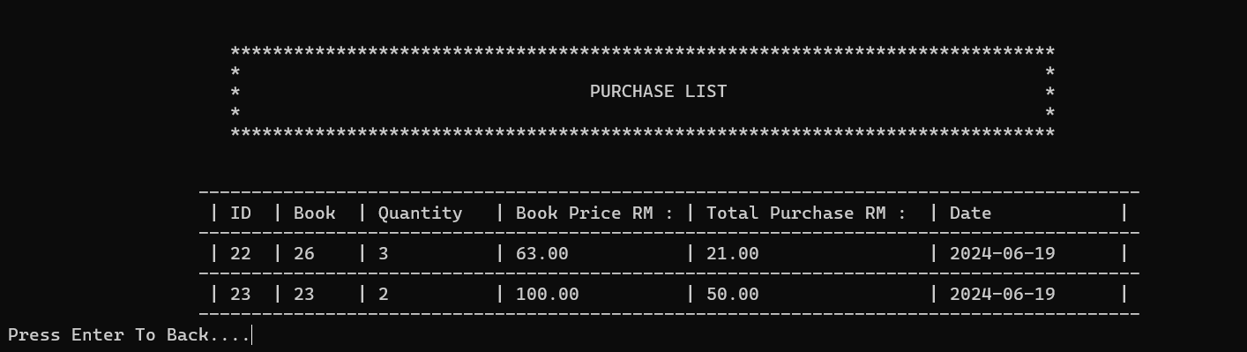

Slide 20
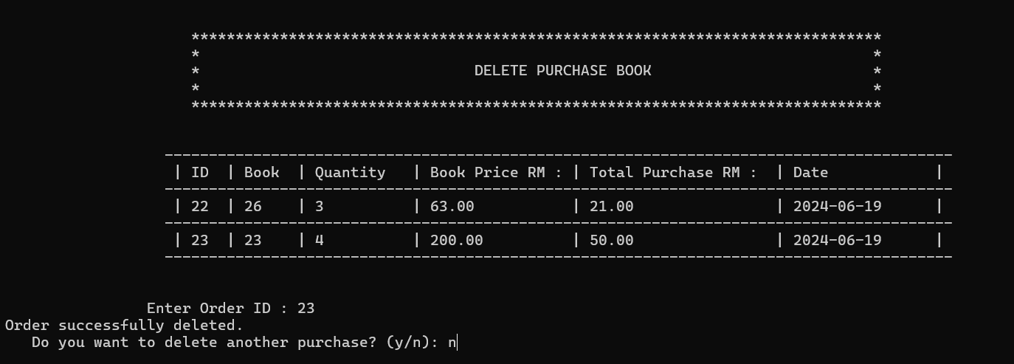
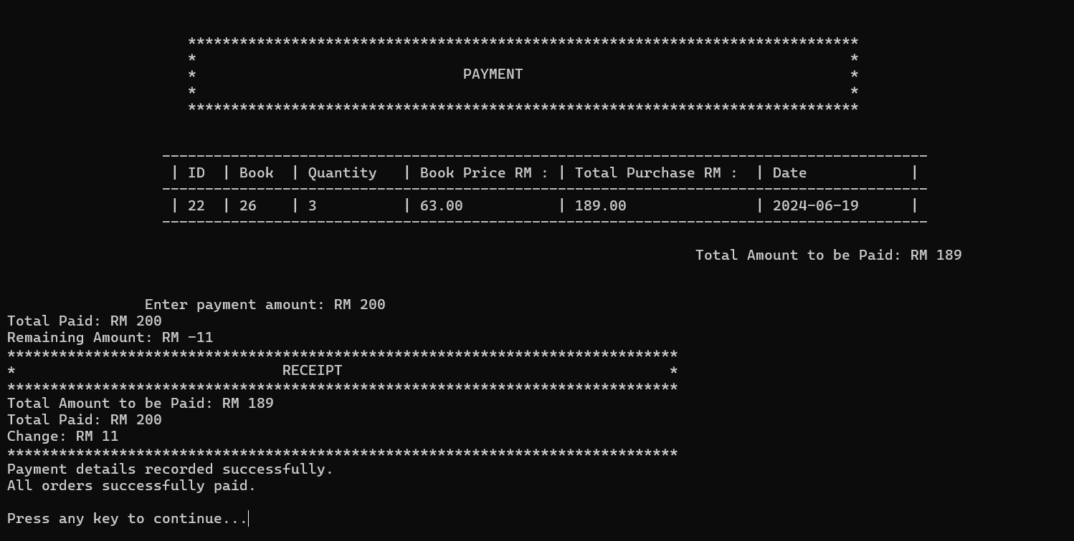

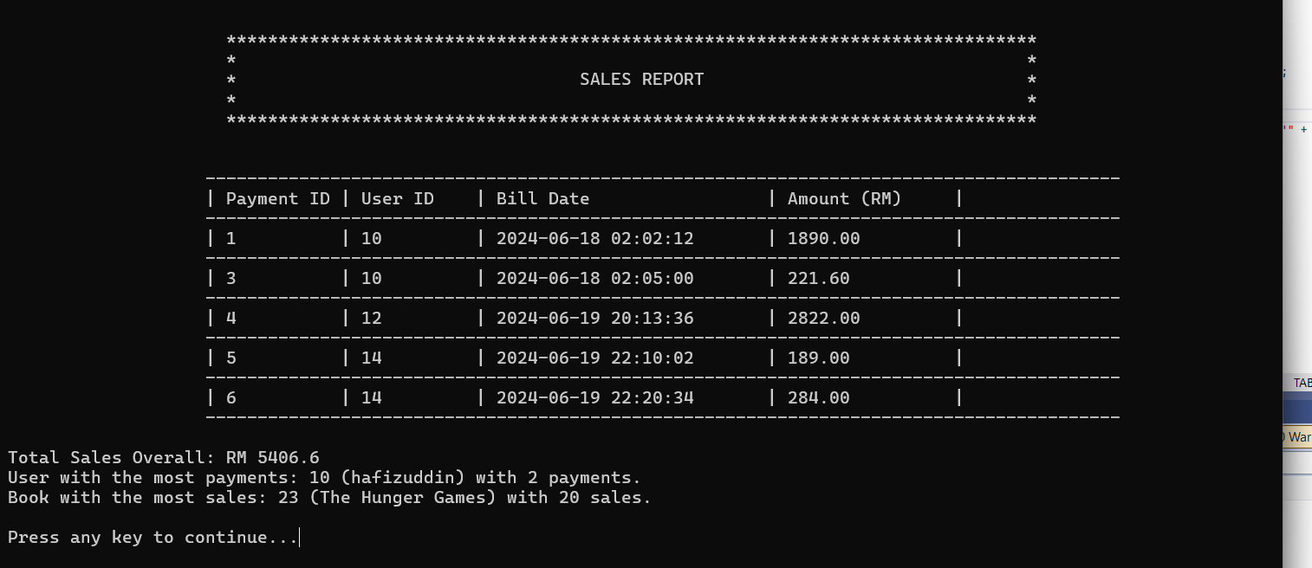

Slide 21


Conclusions
In conclusion, the bookstore management system is an important part of the daily operation of the bookstore. However, to ensure its continued improvement and effectiveness, constraints and limitations need to be addressed. Future improvements discussed are integration with external platforms, advanced reporting and analysis capabilities, enhanced security measures. By embracing these improvements, bookstores can optimize their operations, adapt to evolving market dynamics, and ultimately provide an enhanced customer experience in-store.

Slide 22

DEMONSTRATION

Slide 23
THANK YOU

